Slide 1
SQL SELECT

Slide 2

Objectives
Snowflake automation
SQL Basics
Where function
String functions
Joins
Style guides
Hierarchy
Subqueries
Types
Where to be used
Best practices
Sub query vs CTE
Advanced SQL Functions
Coalesce
Windowing functions
Regex
More advanced querying
Data Types
Flattening Arrays

Slide 3
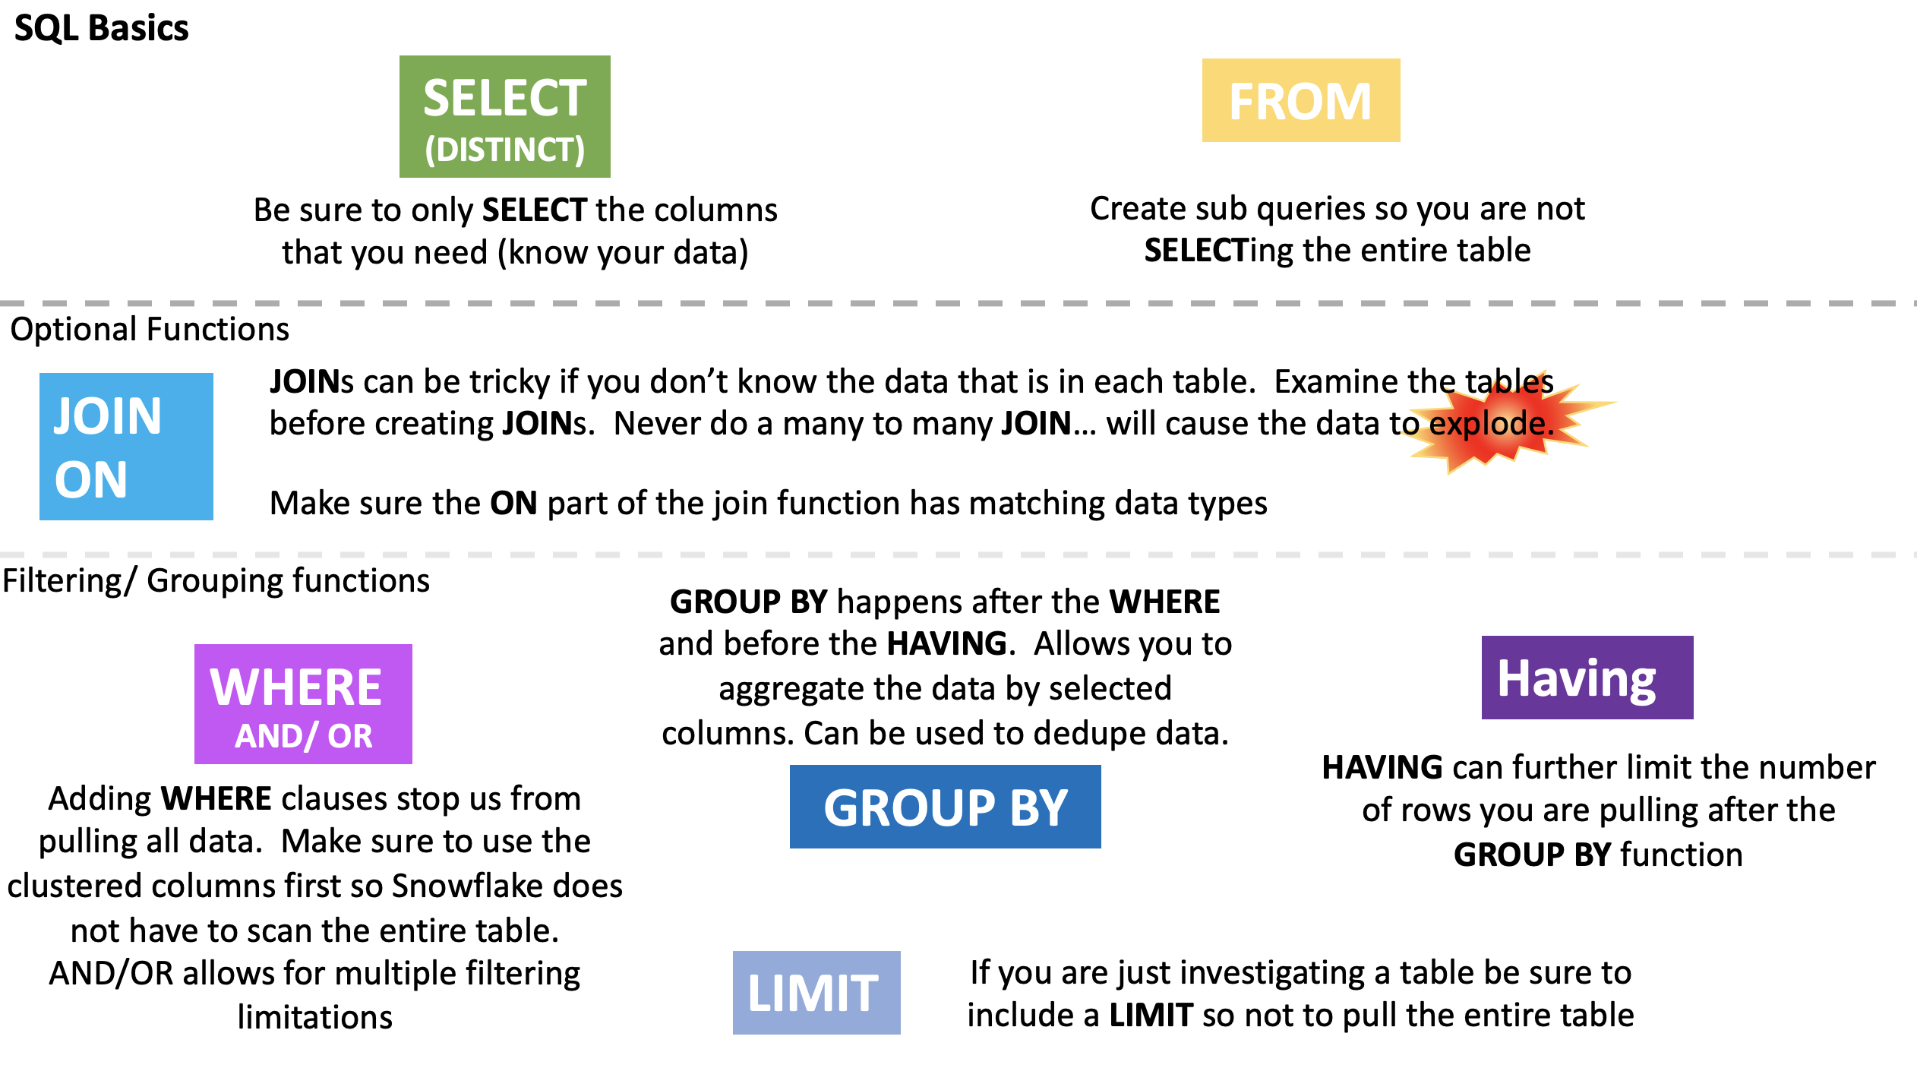
Snowflake Automation
Dynamic query optimization:
Ensures that Snowflake operates as efficiently as possible by looking at the state of the system when a query is dispatched for execution,
Looks at it multiple times – not just when it is compiled
USE THE SQL THAT YOU ALREADY KNOW
Rather than dealing with NOSQL and the like you can use SQL that your team is already familiar with to create dynamic, powerful, fast moving queries.

Slide 5
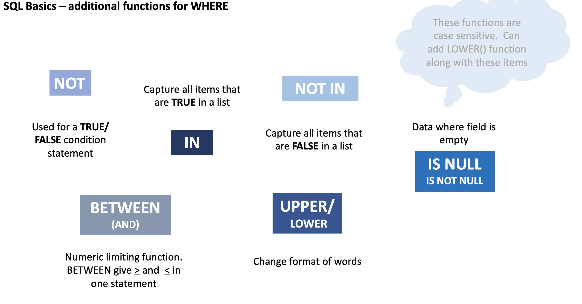

Slide 6
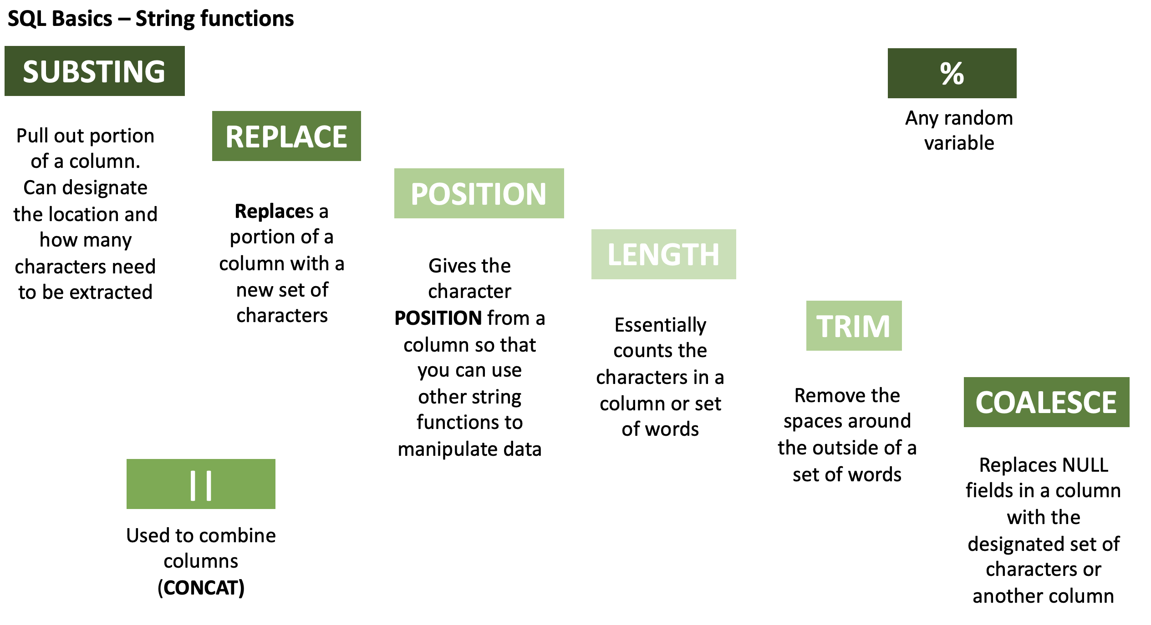

Slide 7
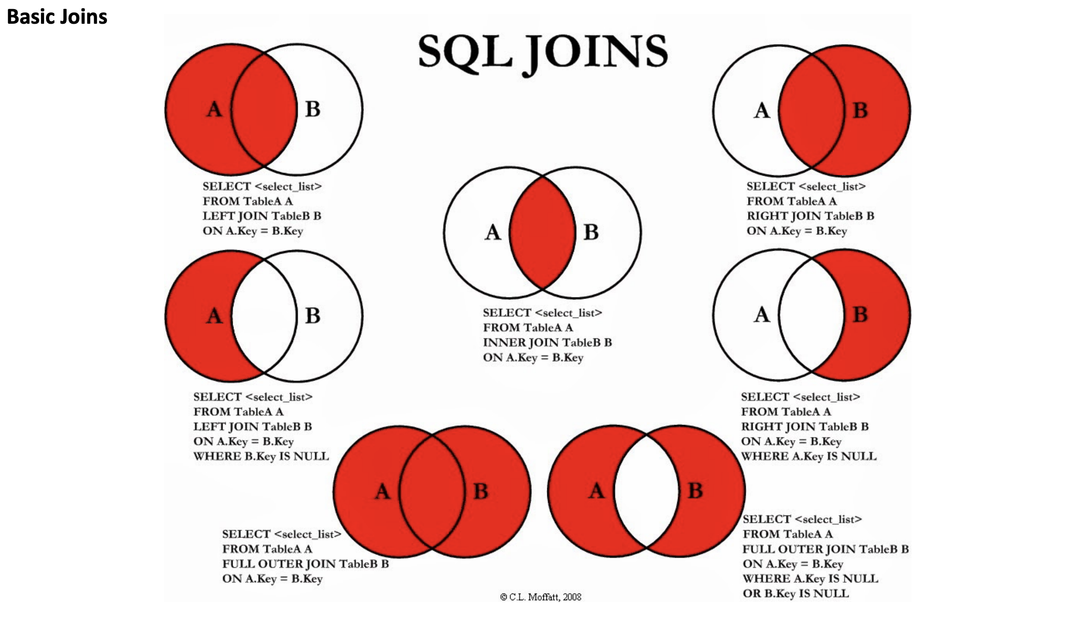

Slide 8

SQL Style Guides
CAPITALIZE all functions or use SQL formatting
Indents should be four spaces. Don’t use tab as it can break some systems
Lines of SQL should be no longer than 80 characters
Field names should all be lowercase
The as keyword should be used when aliasing a field or table
Fields should be stated before aggregates / window functions
Use the full column name for GROUP BYs and ORDER BYs

Slide 9
Style Guides Continued
Specify join keys - do not use using… will not work in Snowflake
Prefer union all to union *
Avoid Initialisms in joins. C is much harder to figure out than customers
If selecting data from joined table prefix the table name in front of the column so that it is easy to see where it come from
Be explicit about your join (i.e. write inner join instead of join). left joins are normally the most useful, right joins often indicate that you should change which table you select from and which one you join to.

Slide 10


Hierarchy of SQL Functions
Mini Lab Breakout SELECT Statement Execution Order
SELECT DISTINCT <TOP_specification> <select_list>
FROM
(SELECT <select_list>
FROM <left_table> <join_type>
JOIN <right_table>
ON <join_condition> ) X
WHERE <where_condition>
GROUP BY <group_by_list>
HAVING <having_condition>
ORDER BY <order_by_list>
Notes:
FROM clause
ON clause
OUTER clause
WHERE clause
GROUP BY clause
HAVING clause
SELECT clause
DISTINCT clause
ORDER BY clause
TOP clause
Tips & Cautions
Aliases created in the SELECT list cannot be used by earlier steps.
This restriction is imposed because the column value may not yet have been determined when the clauses that appear before the SELECT clause are evaluated (such as the WHERE clause).
In some databases (such as MySQL), using aliases created in the SELECT list is allowed in GROUP BY and HAVING clause,
even though these clauses appear before (and are evaluated earlier than) the SELECT clause.
Expression aliases cannot be used by other expressions within the same SELECT list.
This is because the logical order in which the expressions are evaluated does not matter and is not guaranteed.
For example, this SELECT clause might not work as expected, and is therefore, not supported: SELECT a + 1 AS x, x + 1 AS y
When using an INNER JOIN, it doesn’t matter if you specify your logical expressions in the WHERE clause or the ON clause.
This is true because there's no logical difference between the ON and WHERE (except for when using an OUTER JOIN or GROUP BY ALL option).
The DISTINCT clause is redundant when GROUP BY is used.
Therefore, it would not remove any rows from the recordset.

Slide 11

Subqueries
Correlated vs Uncorrelated
Correlated refers to one or more columns from outside of the subquery
Uncorrelated has no such external column references. It is an independent query
Scalar vs Non-Scalar
Scalar subquery returns a single value (one column of one row)
Non-Scalar subquery returns 0 to multiple rows, each of which may contain 1 to multiple columns
SELECT p.name, p.annual_wage, p.country
FROM pay as p WHERE p.annual_wage <
(SELECT max(per_capita_gdp) FROM international_gdp i WHERE p.country = i.name);
SELECT c1, c2 FROM table1
WHERE c1 =
(SELECT max(x) FROM table2);
SELECT p.name, p.annual_wage, p.country FROM pay as p WHERE p.annual_wage < (SELECT per_capita_gdp FROM international_gdp WHERE name = 'Brazil');
Notes:
-- Uncorrelated subquery: select c1, c2 from table1 where c1 = (select max(x) from table2); -- Correlated subquery: select c1, c2 from table1 where c1 = (select x from table2 where y = table1.c2);
uncorrelated subquery in a where clause. The subquery gets the per capita GDP of Brazil, and the outer query selects all the jobs (in any country) that pay less than the per-capita GDP of Brazil.
The subquery is uncorrelated because the value that it returns does not depend upon any column of the outer query.
The subquery only needs to be called once during the entire execution of the outer query.
Uncorrelated - select p.name, p.annual_wage, p.country from pay as p where p.annual_wage < (select per_capita_gdp from international_gdp where name = 'Brazil’);
correlated subquery in a where clause. The query lists jobs where the annual pay of the job is less than the per-capita GDP in that country.
This subquery is correlated because it is called once for each row in the outer query and is passed a value, p.country (country name), from the row.
Correlated sub query - select p.name, p.annual_wage, p.country from pay as p where p.annual_wage < (select max(per_capita_gdp) from international_gdp i where p.country = i.name);

Slide 12
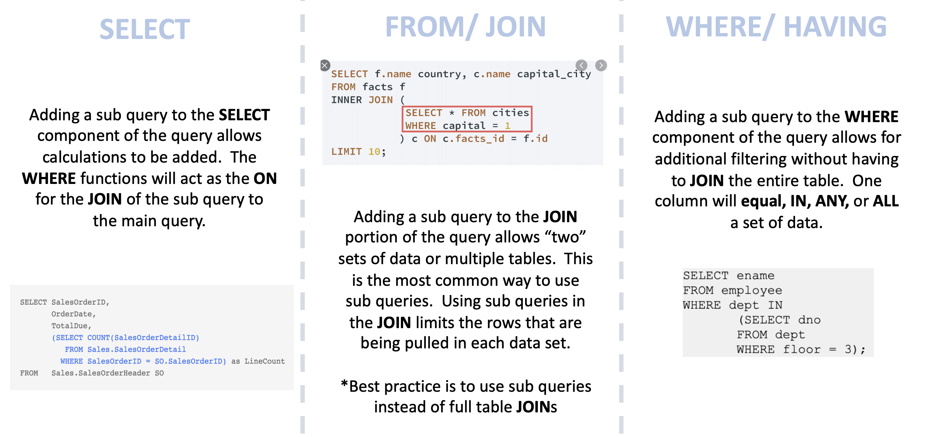
Subqueries – Where can they be used
Notes:
Where can you put subqueries ( use slide I created for SQL class)
Subquery operators operate on nested query expressions. They can be used to compute values that are:
Returned in a SELECT list.
Grouped in a GROUP BY clause.
Compared with other expressions in the WHERE or HAVING clause
Limitations
Although subqueries can contain a wide range of SELECT statements, they have the following limitations:
Some clauses are not allowed inside of ANY/ALL/NOT EXISTS subqueries.
The only type of subquery that allows a LIMIT / FETCH clause is an uncorrelated scalar subquery. Also, because an uncorrelated scalar subquery returns only 1 row, the LIMIT clause has little or no practical value inside a subquery.

Slide 13

Subqueries Best Practices
Best Practices
Never use a SELECT *
Always pick only the columns you need
Use with functions like
IN, NOT IN, EXISTS, ANY, ALL, and comparison operators
Move the subquery around based on where it is being used
Label the SQ based on the table name add levels of depth
Comment your code
You may have a great memory, but rarely can you remember everything a year ago
Notes:
Pull up some examples of some code

Slide 14
Sub Queries vs CTE
CTE
SUBQUERY
WITH avg_pet_count_over_time
AS ( SELECT cat_id, MAX(timestamp)::DATE AS max_pet_date, MIN(timestamp)::DATE AS min_pet_date
FROM cat_pet_fact GROUP BY cat_id )
SELECT cat_name, max_pet_date
FROM cat_dim
LEFT JOIN avg_pet_count_over_time
ON cat_dim.cat_id = avg_pet_count_over_time.cat_id;
SELECT cat_name, max_pet_date FROM cat_dim
LEFT JOIN (
SELECT cat_id, MAX(timestamp)::DATE AS max_pet_date, MIN(timestamp)::DATE AS min_pet_date
FROM cat_pet_fact GROUP BY cat_id ) AS avg_pet
ON cat_dim.cat_id = avg_pet.cat_id;
1.3MB
1.3MB
WITH avg_pet_count_over_time
AS ( SELECT cat_id, MAX(timestamp)::DATE AS max_pet_date, MIN(timestamp)::DATE AS min_pet_date
FROM cat_pet_fact GROUP BY 1 )
SELECT cat_name, t1.max_pet_date, t2.min_pet_date
FROM cat_dim
LEFT JOIN avg_pet_count_over_time as t1
ON cat_dim.cat_id = t1.cat_id
LEFT JOIN avg_pet_count_over_time as t2
ON cat_dim.cat_id = t2.cat_id;
SELECT cat_name, t1.max_pet_date, t2.min_pet_date
FROM cat_dim
LEFT JOIN (SELECT cat_id, MAX(timestamp)::DATE
AS max_pet_date, MIN(timestamp)::DATE AS min_pet_date
FROM cat_pet_fact GROUP BY 1) AS t1
ON cat_dim.cat_id = t1.cat_id
LEFT JOIN (SELECT cat_id, MAX(timestamp)::DATE AS max_pet_date, MIN(timestamp)::DATE AS min_pet_date
FROM cat_pet_fact GROUP BY 1) as t2
ON cat_dim.cat_id = t2.cat_id;
2.7MB
1.3MB
Notes:
Notice right away that the query with the CTE is easier to read and has less redundancy. When I ran this, the CTE statement scanned 1.3MB while the subquery one scanned 2.7MB, doubling the amount of bytes. Why is this? In the CTE query, the compiler knows you’re querying the same data set since it has saved it (albeit temporarily) as avg_pet_count_over_time. In the second query, even though the SQL is the exact same, the compiler does not realize they’re the same query until it runs them. Notice that we have to call the same query by the two distinct aliases: t1 and t2. Not only does this query take more compute and contain redundancy, it also forces us to call the same query two different names. This is misleading; life is much better when both the SQL compiler and your coworkers know when you’re using the same data set rather than creating a new one.
use subqueries in adhoc queries when you need results quickly. If the query is going to be read by others, run every day, or reused, try to use a CTE for readability and performance. Performance may not kick in until the CTE is used twice, but if the second JOIN has to be built in, your syntax will allow for that development more easily

Slide 15
COALESCE Functions
Dealing with Null Data when creating a table
IFNULL, IsNULL, NVL functions
Only allow for one alternative
COALESCE in Snowflake allows for n results
SELECT column1, column2, column3, COALESCE(column1, column2, column3)
In older DBW IsNULL can be slightly slower than COALESCE
COALESCE allows for more variability
Notes:
The differences are miniscule and with snowflake even more so
DEMO

Slide 16

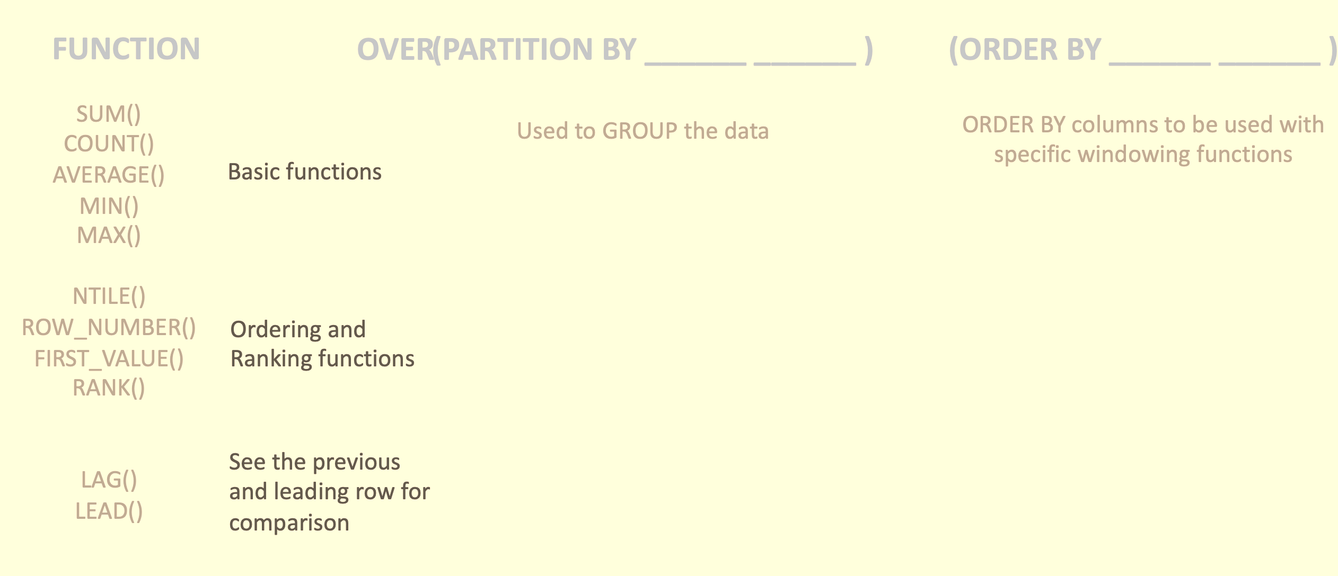

Windowing functions
Window functions operate on groups of rows that are related (e.g. by date or location). Snowflake supports:
General window functions.
Window functions that calculate rank (e.g. highest, second-highest, etc.)
Window functions that support cumulative window frames and sliding window frames
... OVER ( [ PARTITION BY <expr1> ] [ ORDER BY <expr2> [ { cumulativeFrame | slidingFrame } ] ] ) ...
Notes:
https://docs.snowflake.com/en/sql-reference/functions-analytic.html

Slide 17
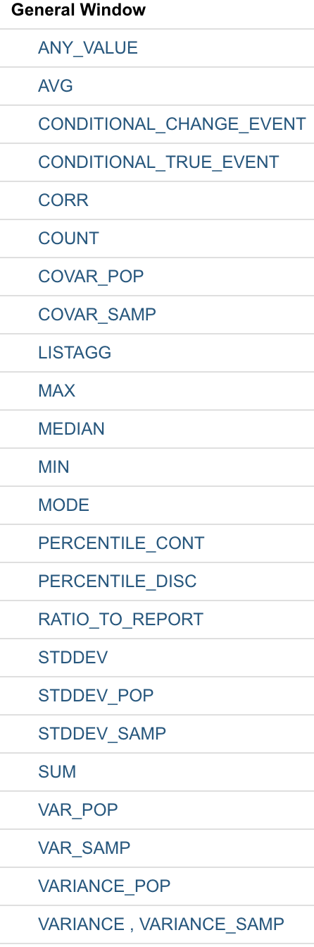
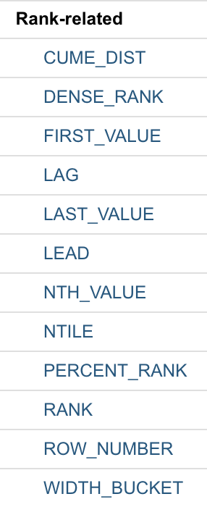
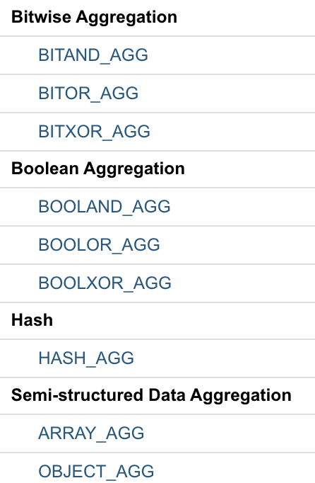
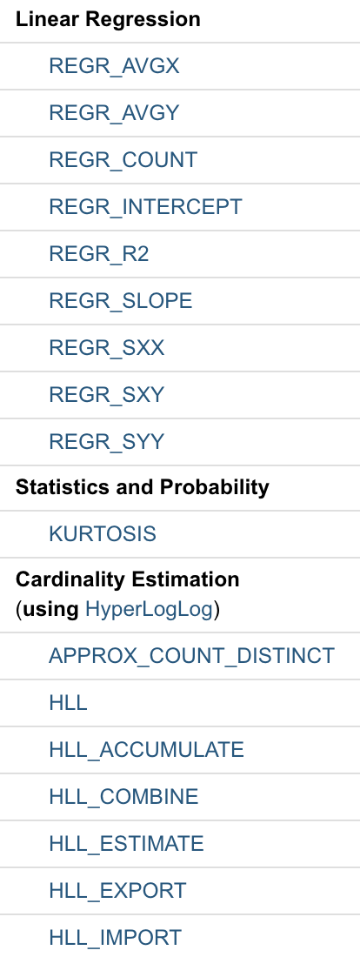
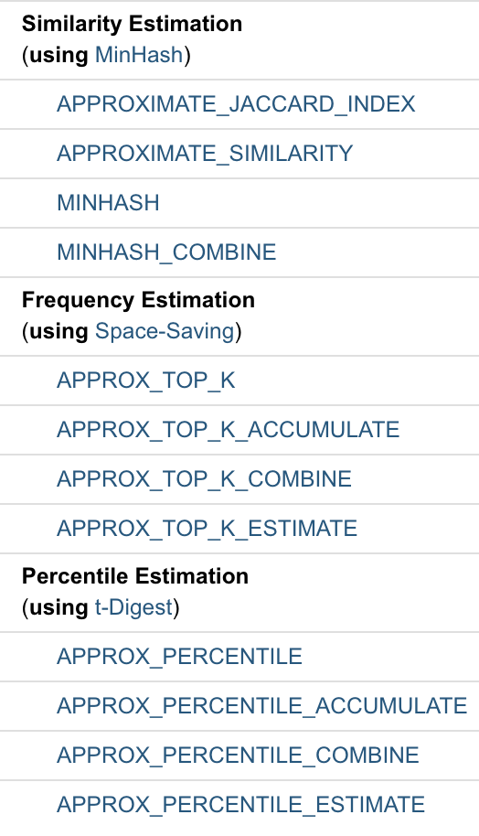
More stuff on windowing functions
What is a window function?
A window function looks at “windows” of your data while processing it
Use frame definitions – to find the data within a specific area
Use PARTITION BY to create multiple windows
Pretty much any aggregate function can become a window function
Notes:
Once you know window functions, you risk putting them all over the place.
Windows can have bounded or unbounded frames as illustrated previously using the PRECEDING and FOLLOWING keywords.
SELECT
FIRST_VALUE(first_name)
OVER(ORDER BY first_name ASC
ROWS 1 PRECEDING) "prev",
first_name,
FIRST_VALUE(first_name)
OVER(ORDER BY first_name DESC
ROWS 1 PRECEDING) "next"
FROM people
ORDER BY first_name ASC
Often, you do not want a single window over your complete data set. Instead, you might prefer to PARTITION your data set into several smaller windows. The following example creates partitions for every first letter in a first name, similar to a phone book:
SQL syntax:
SELECT
first_name,
LEFT(first_name, 1),
COUNT(*) OVER(PARTITION BY LEFT(first_name, 1))
FROM people
ORDER BY first_name
In standards-compliant SQL databases, every aggregate function (even user-defined aggregate functions) can be turned into a window function by adding the OVER() clause. Such a function can then be used without any GROUP BY

Slide 18
REGEX
String functions perform operations that match a regular expression (regex)
Usually follow a pattern but do not have to
\d: decimal digit (0-9)
\D: not a decimal digit
\s: whitespace character
\S: not a whitespace character
\w: “word” character (a-z, A-Z, underscore (“_”), or decimal digit)
\W: not a word character
\b: word boundary
\B: not a word boundary
In General, the Longer Regex Is the Better Regex
The faster you can throw out non-matching input, the fewer cycles you waste
More documentation available at https://perldoc.perl.org/perlrecharclass.html#Backslash-sequences
Notes:
In General, the Longer Regex Is the Better Regex
The second regular expression is indeed better than the first. Why is that? A good indicator is that it is longer. Good regular expressions are often longer than bad regular expressions because they make use of specific characters/character classes and have more structure. This causes good regular expressions to run faster as they predict their input more accurately.
The faster you can throw out non-matching input, the fewer cycles you waste (not to mention, the more precise your regexes are, the less likely you are to accidentally match text that you didn’t mean to match). In the above example, we know that our matching input will always start with a time stamp. We’ve encoded that fact in the better regex, even though we are not extracting any information from the time stamp itself.
Should you ever find yourself writing a latency-sensitive application that makes very frequent use of regular expressions, you could save yourself a lot of cycles by crafting a regex that is as precise as possible. These particular examples were very limited, considering the infinite breadth of possible regexes and inputs. They were intended to demonstrate the magnitude of difference between well-crafted regexes and naive regexes, between the champion bowler and the drunkard. To suit your own use cases, you will need to carefully consider exactly what it is you are trying to match.
https://regexr.com/

Slide 19
More Advanced querying
Querying semi structured data
Arrays allow data to be stored that is not used regularly
Arrays can be flattened if it needs to be accessed
Example of an array:
Using Sequences
Sequences are used to generate unique numbers across sessions and statements, including concurrent statements.
They can be used to generate values for a primary key or any column that requires a unique value
select vm.value:make::string as make, vm.value:model::string as model, ve.value::string as "Extras Purchased" from car_sales , lateral flatten(input => src:vehicle) vm , lateral flatten(input => vm.value:extras) ve;
"vehicle" : [ {"make": "Toyota", "model": "Camry", "year": "2017", "price": "23500", "extras":["ext warranty", "rust proofing", "fabric protection"]}
Notes:
Example of an array "vehicle" : [ {"make": "Toyota", "model": "Camry", "year": "2017", "price": "23500", "extras":["ext warranty", "rust proofing", "fabric protection"]}
Snowflake sequences currently utilize the following semantics:
All values generated by a sequence are globally unique as long as the sign of the sequence interval does not change. Concurrent queries never observe the same value, and values within a single query are always distinct.

Slide 20
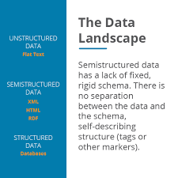
Snowflake Data Types
Snowflake offers native ingestion of various data types that other data warehouses don’t.
Have any of you ever been in a scenario where you needed to load, say, an XML or a multi-dimensional JSON into a structured SQL database?
How did you have to manipulate that data?
How much work did it take to get it in there?
Did you have to flatten it first?
The makers of snowflake felt your pain here and offer the VARIANT data type.
Notes:
Float int problem
Divide an int by another int and then aggregate it
½ - then you get 0 unless you cast one into a float first

Slide 21
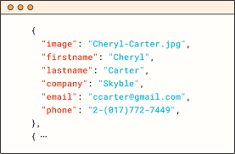
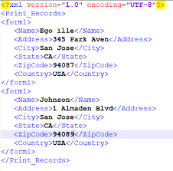
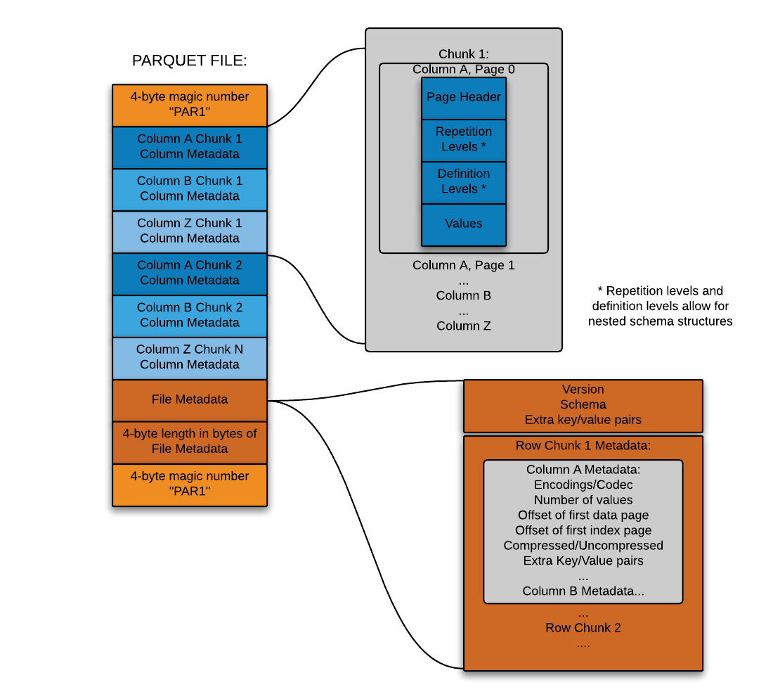
Snowflake data types
Snowflake started by making it possible to flexibly store semi-structured records inside a relational table in native form
This is accomplished through a custom datatype (Snowflake’s VARIANT datatype) that allows schema-less storage of hierarchical data, including JSON, Avro, XML and Parquet
This makes it possible to load semi-structured data directly into Snowflake without pre-processing, losing information, or defining a schema
You simply create a table containing a column with Snowflake’s VARIANT datatype and then load files containing semi-structured data into that table.
JSON
Avro
XML
Parquet

Slide 22
Flattening Arrays
Flattens (explodes) compound values into multiple rows
SEQ - A unique sequence number associated with the input record; the sequence is not guaranteed to be gap-free or ordered in any particular way
KEY - For maps or objects, this column contains the key to the exploded value
PATH - The path to the element within a data structure which needs to be flattened
INDEX - The index of the element, if it is an array; otherwise NULL
VALUE - The value of the element of the flattened array/object
THIS - The element being flattened (useful in recursive flattening)
Dot or bracket format to flatten semi structured data
JSON object: <column>:<level1_element>.<level2_element>.<level3_element>
an object: <column>['<level1_element>']['<level2_element>’]
Parsing Arrays Directly from a Staged Data File
FLATTEN( INPUT => <expr> [ , PATH => <constant_expr> ]
[ , OUTER => TRUE | FALSE ]
[ , RECURSIVE => TRUE | FALSE ]
[ , MODE => 'OBJECT' | 'ARRAY' | 'BOTH' ] )

Slide 23

Confused? ASK QUESTIONS

Slide 24
Break & Lab4

